Slide 1
DSC 640 – Exercise 2.2
Ramsey king

Slide 2
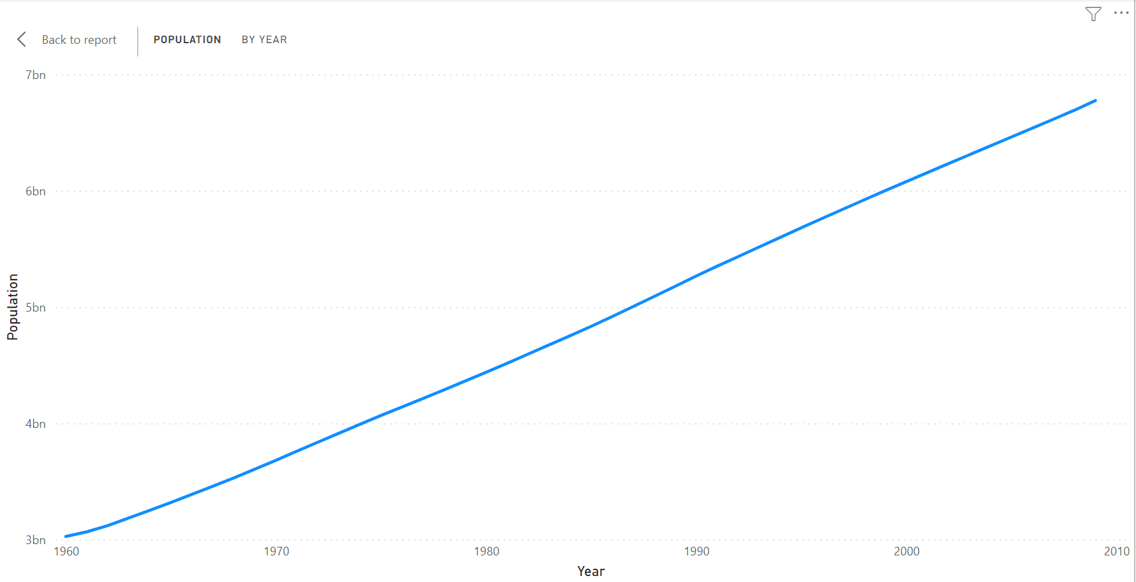
Power bi – line chart

Slide 3
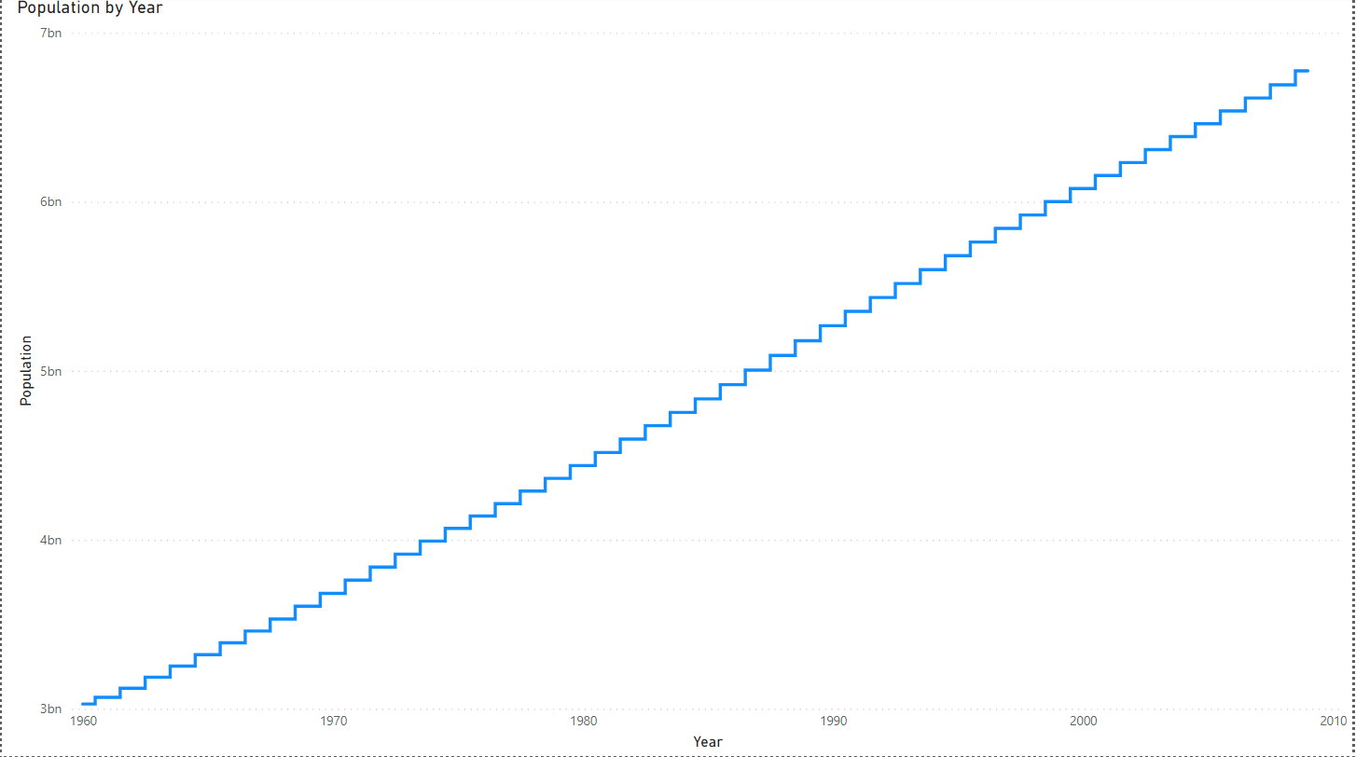
Power bi – step chart

Slide 4
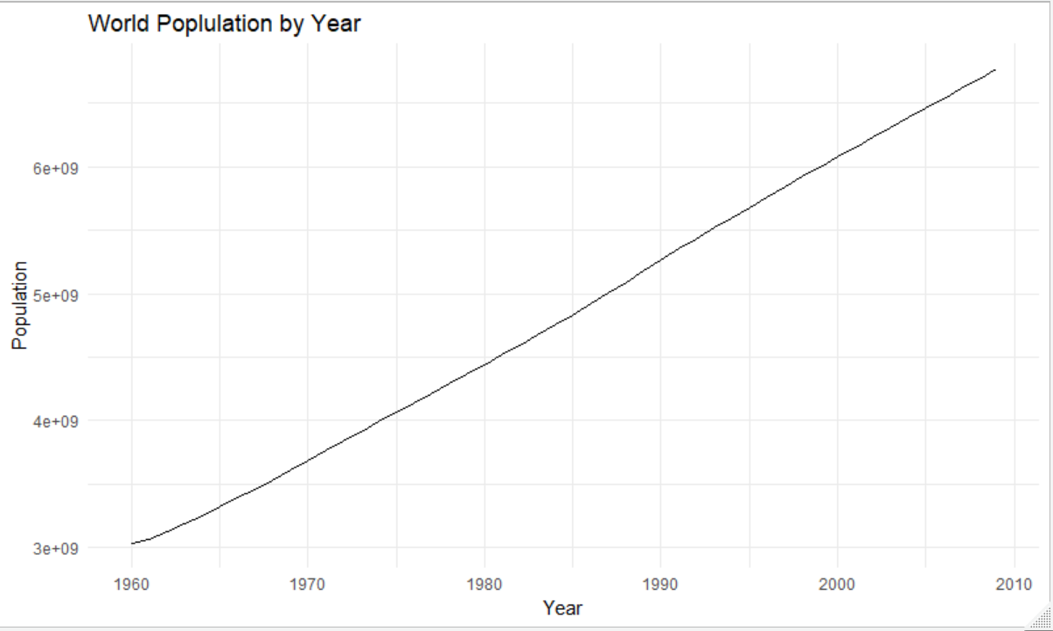
r– line chart

Slide 5
R – step chart

Slide 6
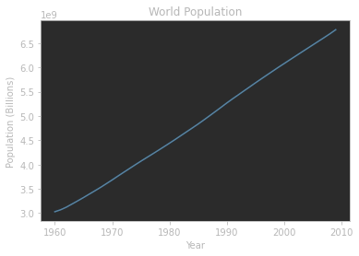
Python – line chart

Slide 7
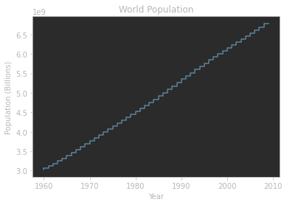
Python – step chart

